Slide 1

Grocery Food Database
Database Design and Analysis
Jean Batista
May 2026
1
1

Slide 2
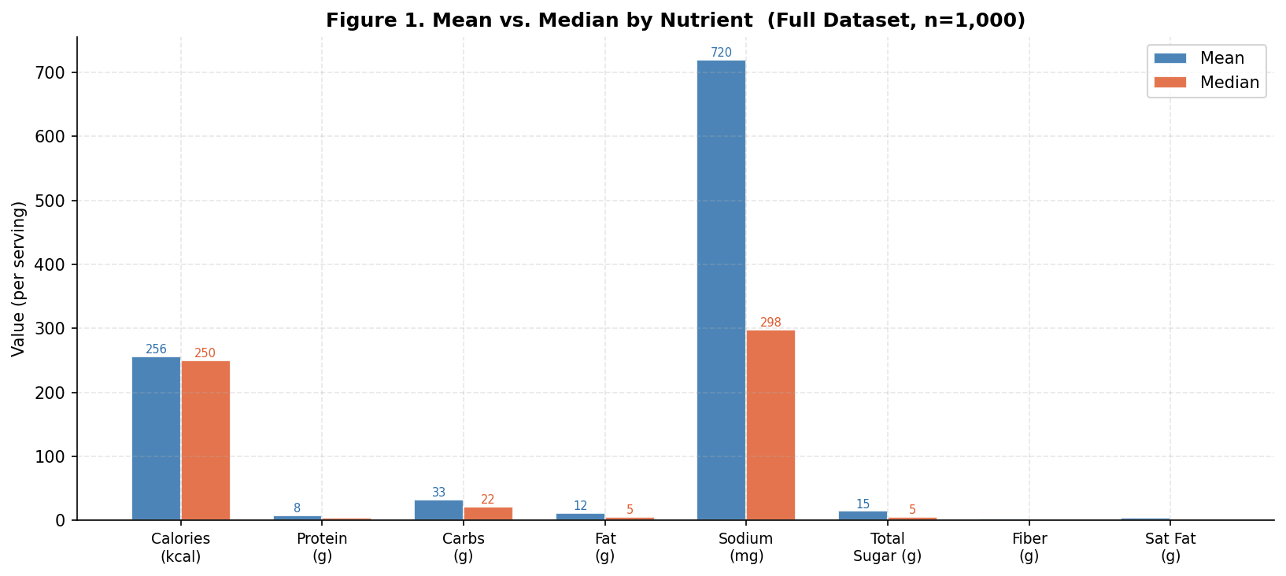
Report 1: Descriptive Statistics
Sodium has the largest outliers. Mean: 720 mg. Median: 298 mg. Extreme outliers pulling the average up. All other nutrients show tight mean/median alignment.
5
Figure 1. Mean vs. Median by Nutrient (n=1,000). Sodium bar shows the largest divergence.

Slide 3
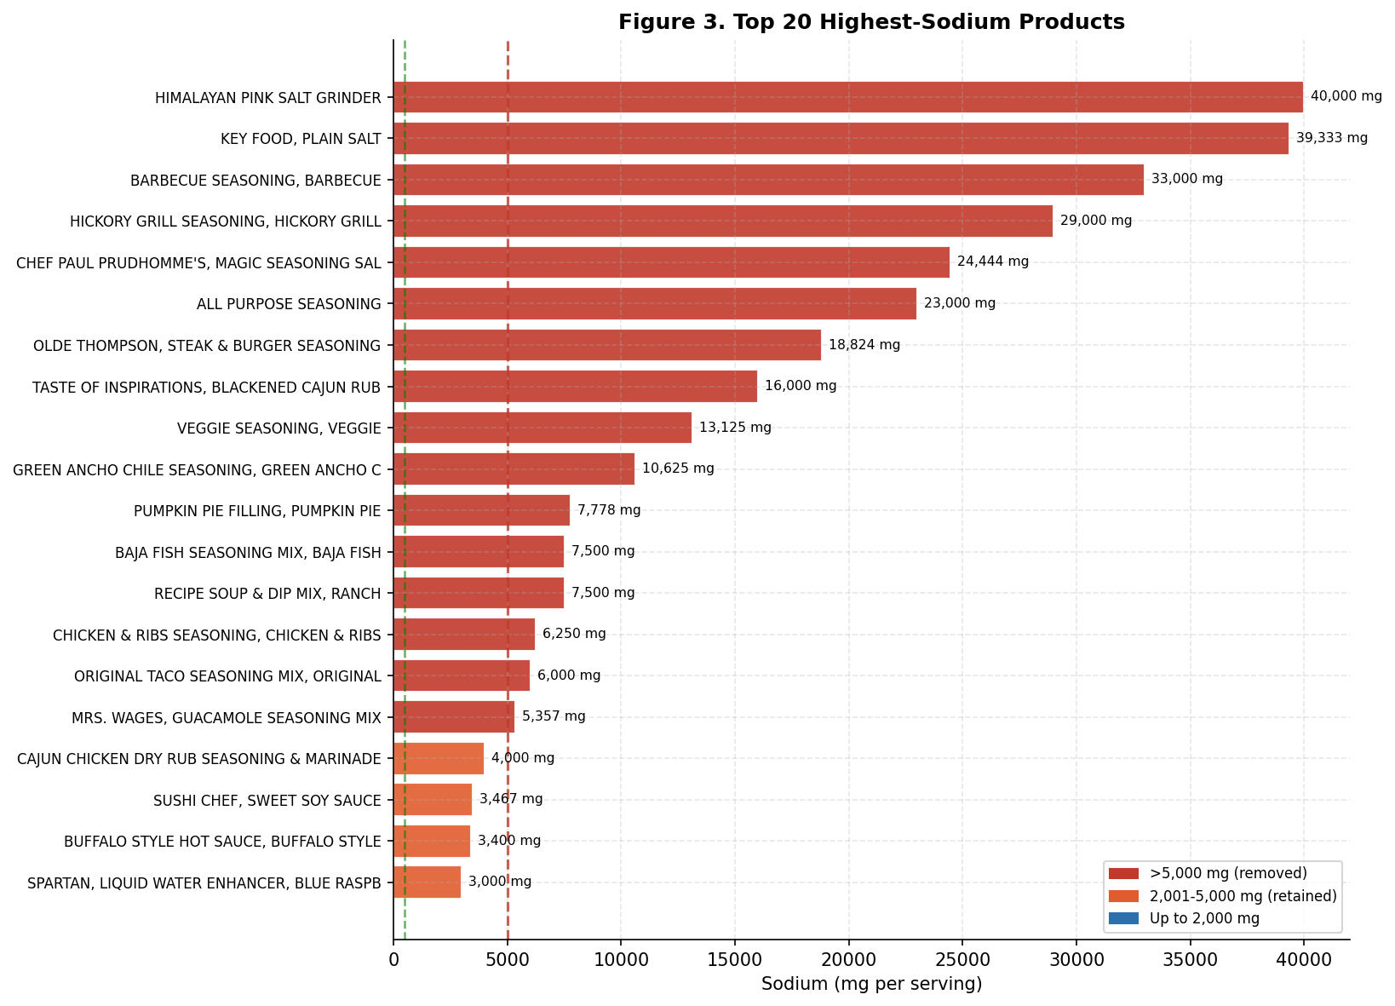
Report 1: Sodium Investigation
Looking into individual products…
16 products exceed 5,000 mg sodium per serving
All 16 are dry spice blends or salts with sub-5g serving sizes
33.4% of all products exceed the FDA high-sodium threshold of 460 mg
Values like 40,000 mg on a 1.5g serving are physically impossible
Rule applied: remove any product with sodium > 5,000 mg
Figure 3. Top 20 highest-sodium products.
6

Slide 4
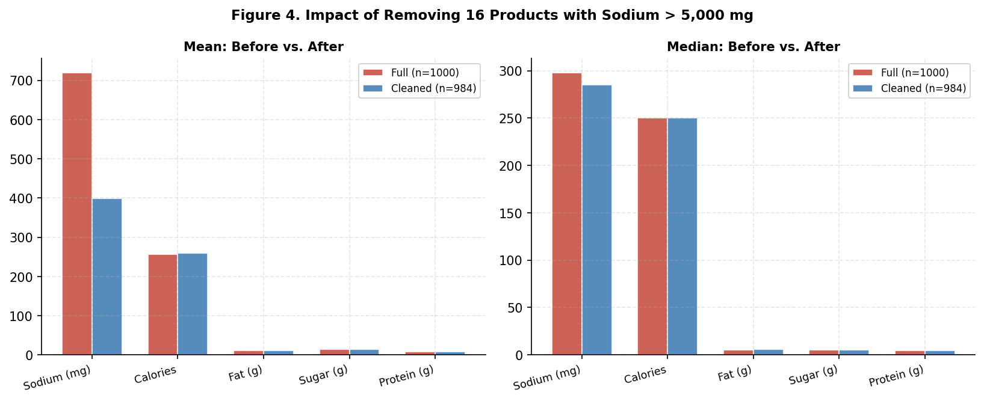
Report 1: Impact of Removing 16 Outliers
Sodium mean drops 44%: 720 mg → 400 mg. Median moves only 12.5 mg (298 → 285). All other nutrients change by less than 3 units.
7

Slide 5
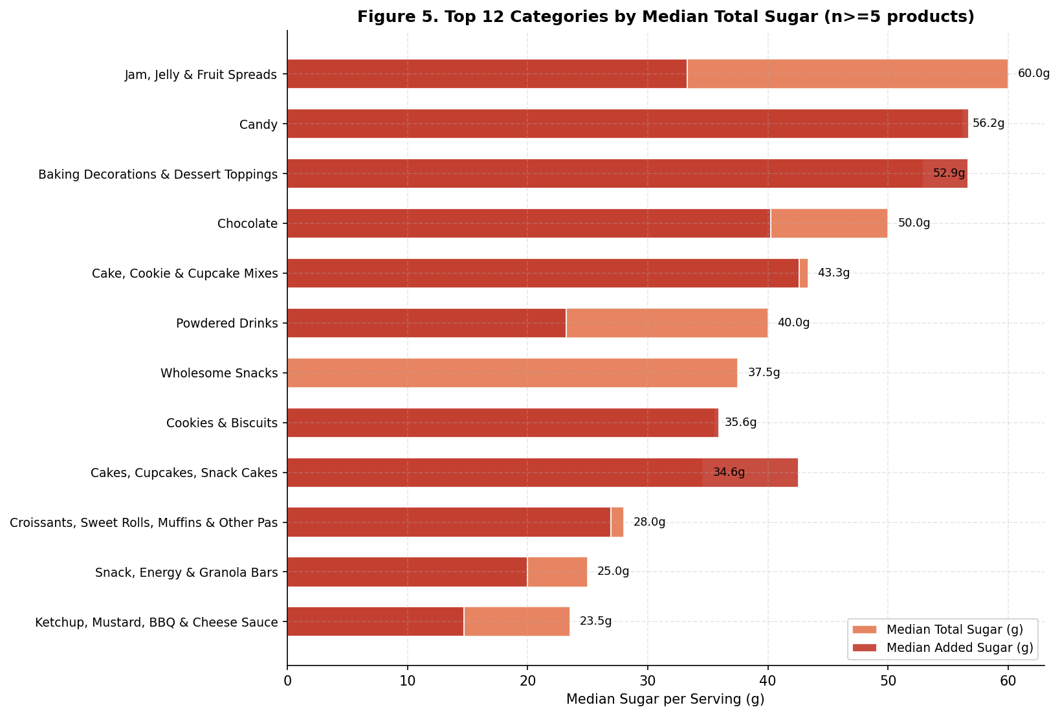
Report 2: Sugar Analysis
The proof is in the pudding.
Jam & fruit spreads lead at 60g median total sugar
Candy, Baking Decorations, Cakes/Snack Cakes: added sugar exceeds total sugar showing data inconsistency/error.
Wholesome Snacks: 37.5g total, 0g added.
Added sugar vs. total sugar gap reveals nutritional quality better than total alone
Figure 5. Median total vs. added sugar by category.
8

Slide 6
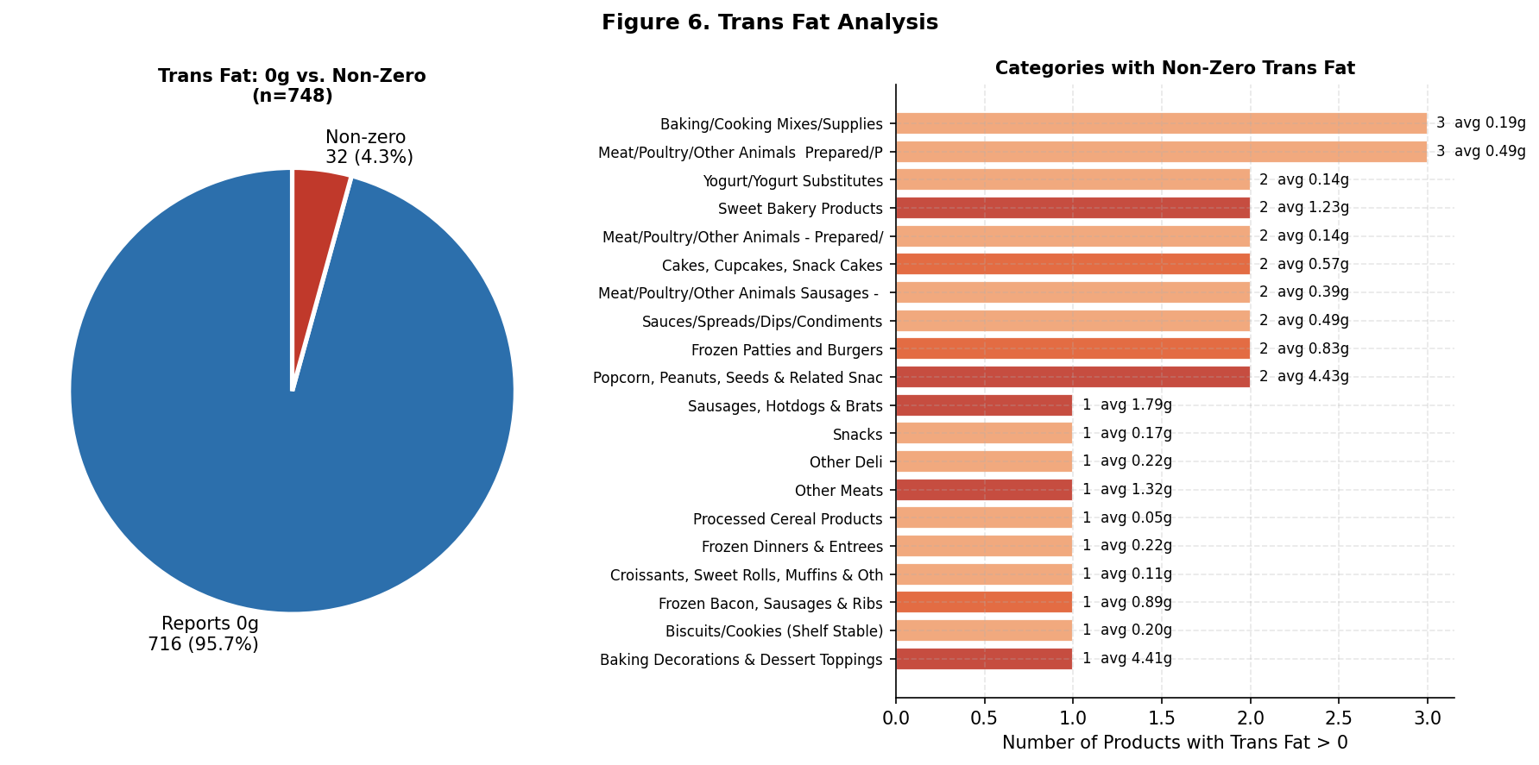
Report 2: Trans Fat
Figure 6. 95.7% of products report 0g trans fat.
Trans fat nearly eliminated post-2018 FDA ruling on partially hydrogenated oils (PHOs)
Remaining non-zero: animal products (natural trans fat) + legacy microwave popcorn (up to 8.75g)
9

Slide 7
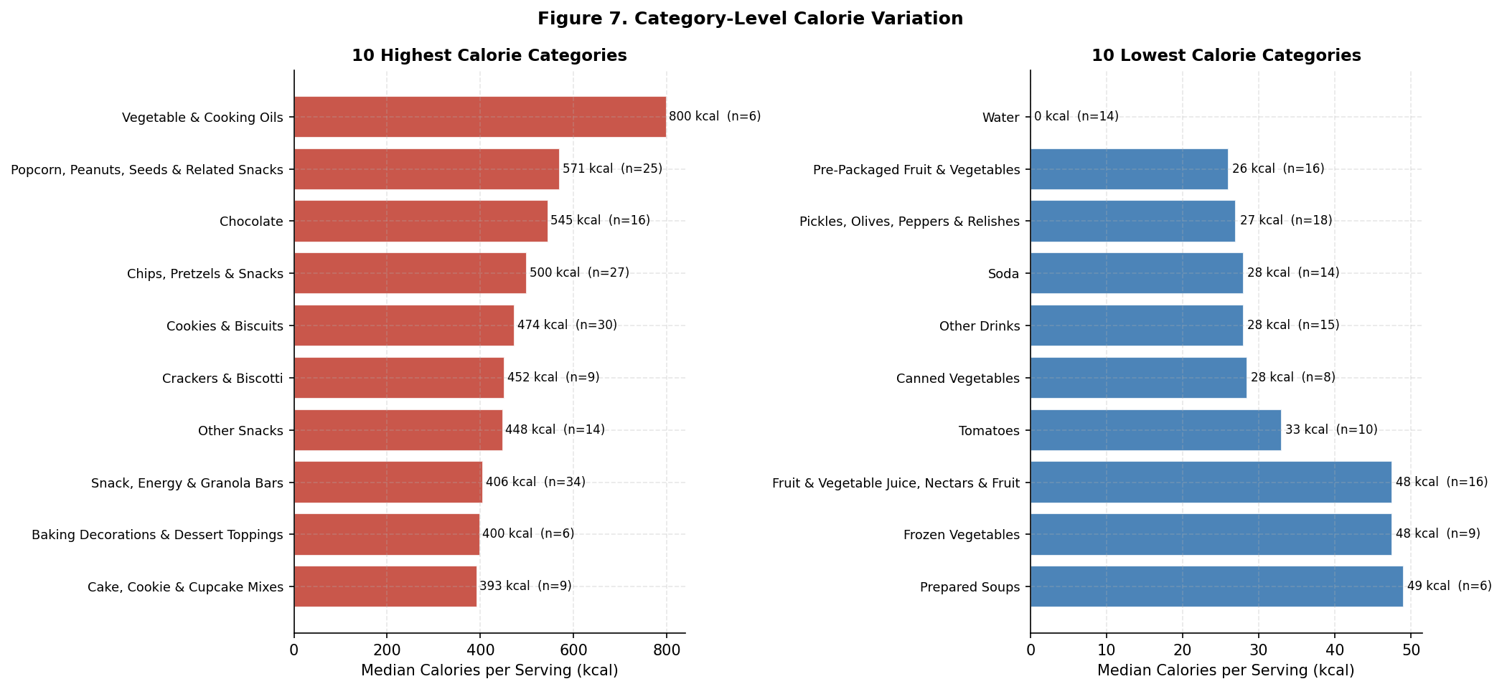
Report 2: Calorie Variation
Figure 7. Highest and lowest calorie categories.
Cooking oils lead calories at 800 kcal median;
Water and vegetables sit near 0 kcal
Soda low calorie count as it has diet options
9

Slide 8
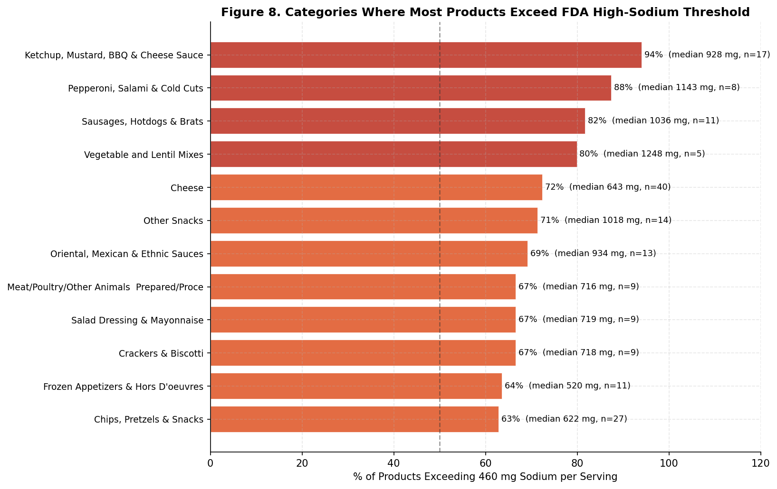
Report 2: Sodium by Category
Key Findings
Condiments: 94% exceed 460 mg. Salt is the primary flavor carrier
Cured meats (pepperoni, salami): 88%
Sausages & hot dogs: 82%
Across most categories, sodium exceeds the FDA threshold
Figure 8. % of products exceeding the FDA 460 mg high-sodium threshold by category.
10

Slide 9
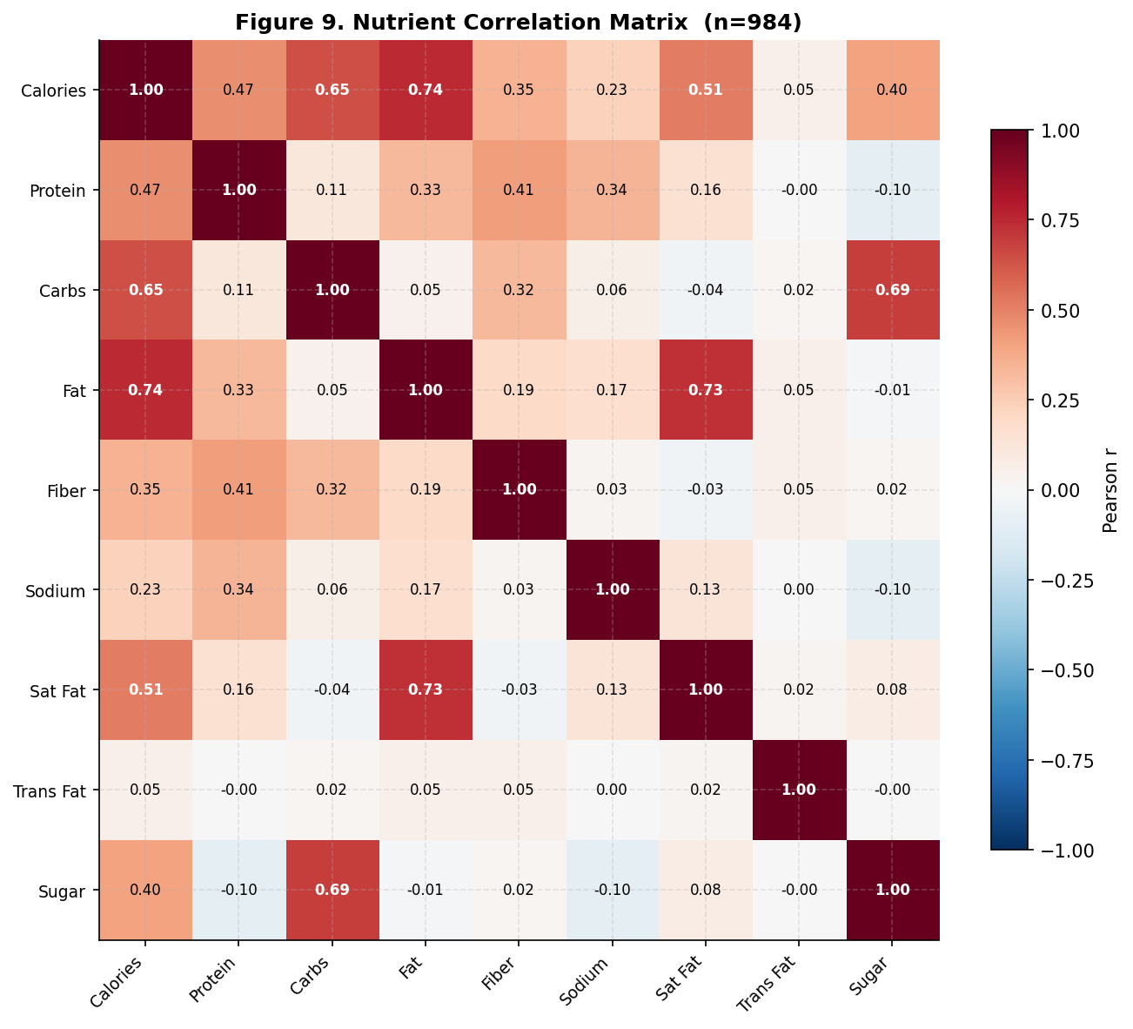
Report 3: Correlations and Macronutrient Composition
Fat & calories: r=0.74 | Fat & sat fat: r=0.73 | Carbs & sugar: r=0.69
Sodium near-zero correlation with carbs, fat, sugar, meaning it is category-driven, not macro-driven
Protein and fiber correlate stronger than fiber and carbs, even though fiber is carbs
Figure 9. Nutrient correlation matrix.
11

Slide 10
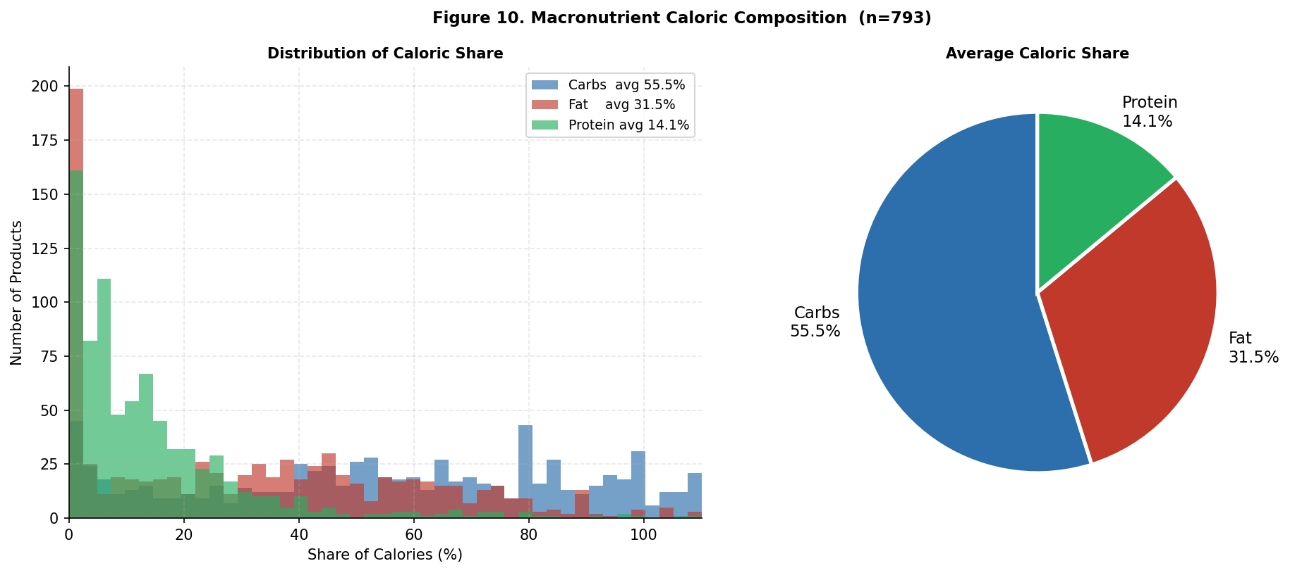
Report 3: Correlations and Macronutrient Composition
Carbs supply 54% of avg calories; fat 32%; protein 14%
Carb distribution is bimodal: 0% (oils/meats) and 80-100% (candy/soda), the avg of 54% is misleading
12

Slide 11
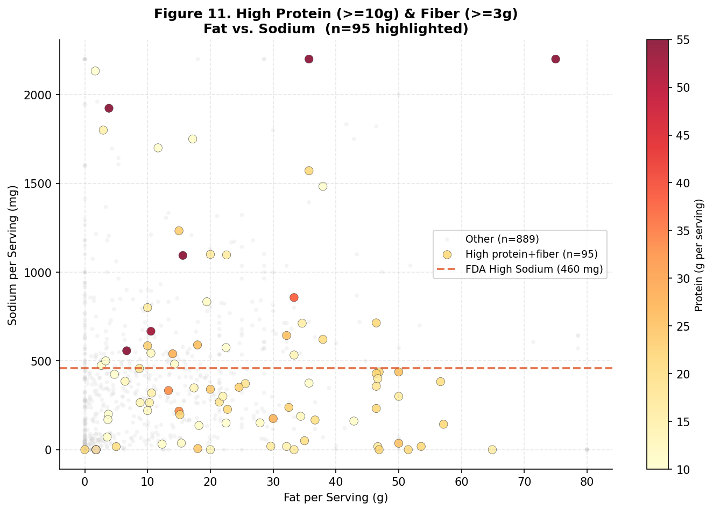
Report 3: Nutritional Quality Findings
What would happen if we filtered for high protein and high fiber?
95 products meet high-protein (>=10g) AND high-fiber (>=3g) , but the avg sodium is 484 mg, above FDA threshold
Many of these products also contain high amounts of fat
Figure 11. High protein+fiber: fat vs. sodium.
13

Slide 12
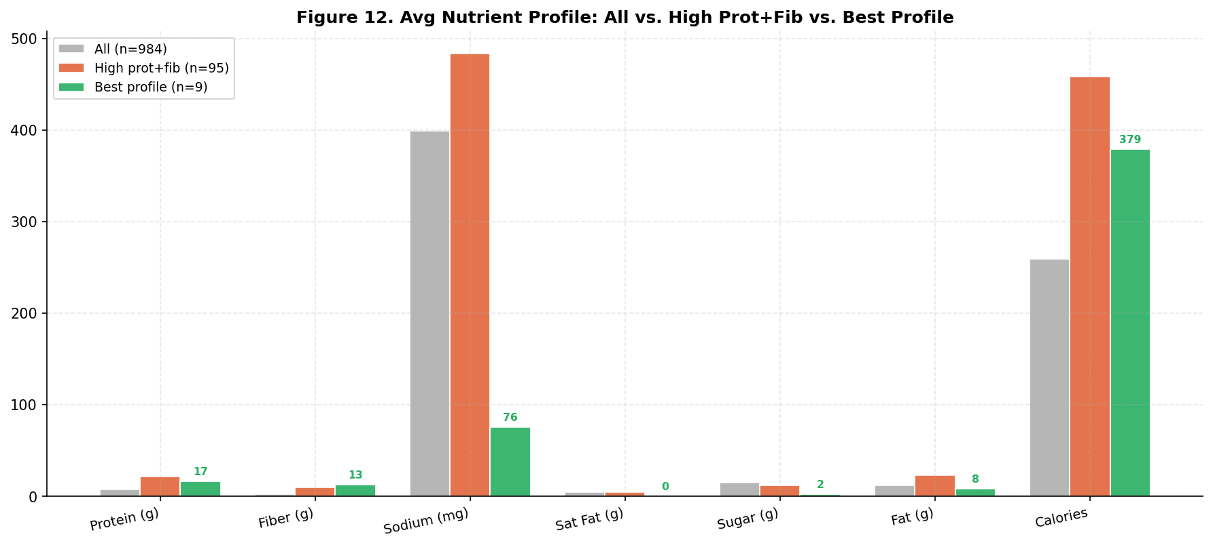
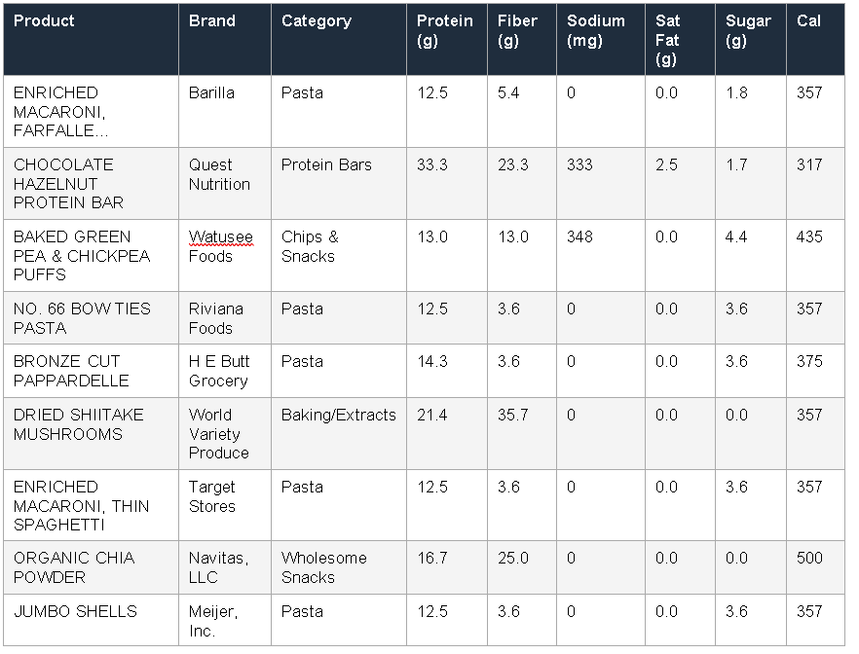
Report 3: Nutritional Quality Findings
Applying 5 simultaneous filters (protein, fiber, sodium, sat fat, sugar) leaves only 9 of 984 products (0.9%)
5 of 9 are dry pasta, high protein/fiber, zero sodium, zero added sugar
Remaining: dried shiitake mushrooms, chia powder, one chickpea puff, one Quest protein bar
Figure 12. Best nutrition profile vs. all products.
14

Slide 13


